Slide 2

Linear Arrival Rate
# of calls present
Variance
Base Arrival Rate

Slide 3

Birth/Death Process

Slide 4
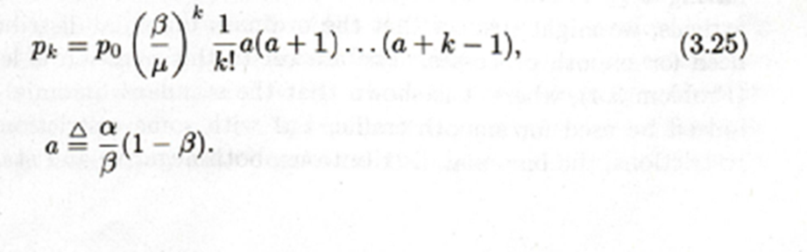


x= Beta/mu

Slide 5
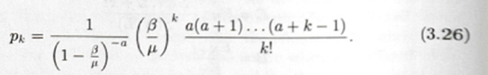
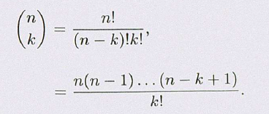



Slide 6
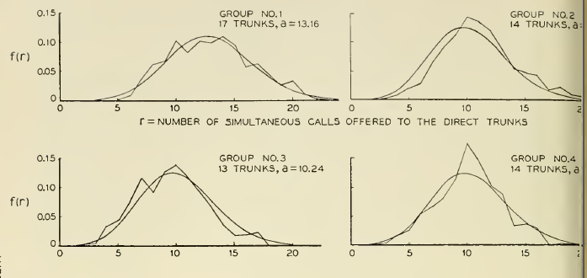

Slide 7
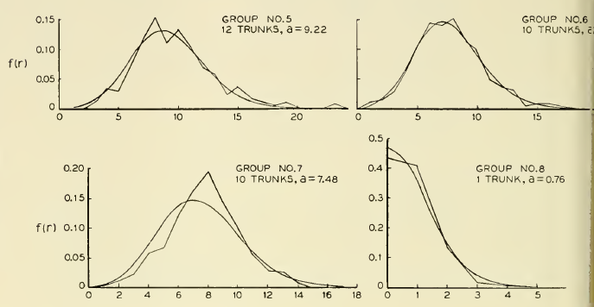

Slide 8
